Slide 1

Project Title: Data Cleaning Project – Global Electronics Sales

Slide 2
Introduction
What is data cleaning?
Data cleaning is the process of identifying and correcting inaccurate, incomplete, or irrelevant data to improve quality.
Why it’s essential?
Ensures high-quality inputs for analyticsBoosts performance of ML modelsReduces errors in decision-makingPrepares data for visualization and reporting.

Slide 3
Dataset:
>2,000+ records of electronic gadget sales across countries.
>Includes sales amount, customer details, and product information
>Target metrics: Total_Sale, Review_Rating, Sale_Date.

Slide 4
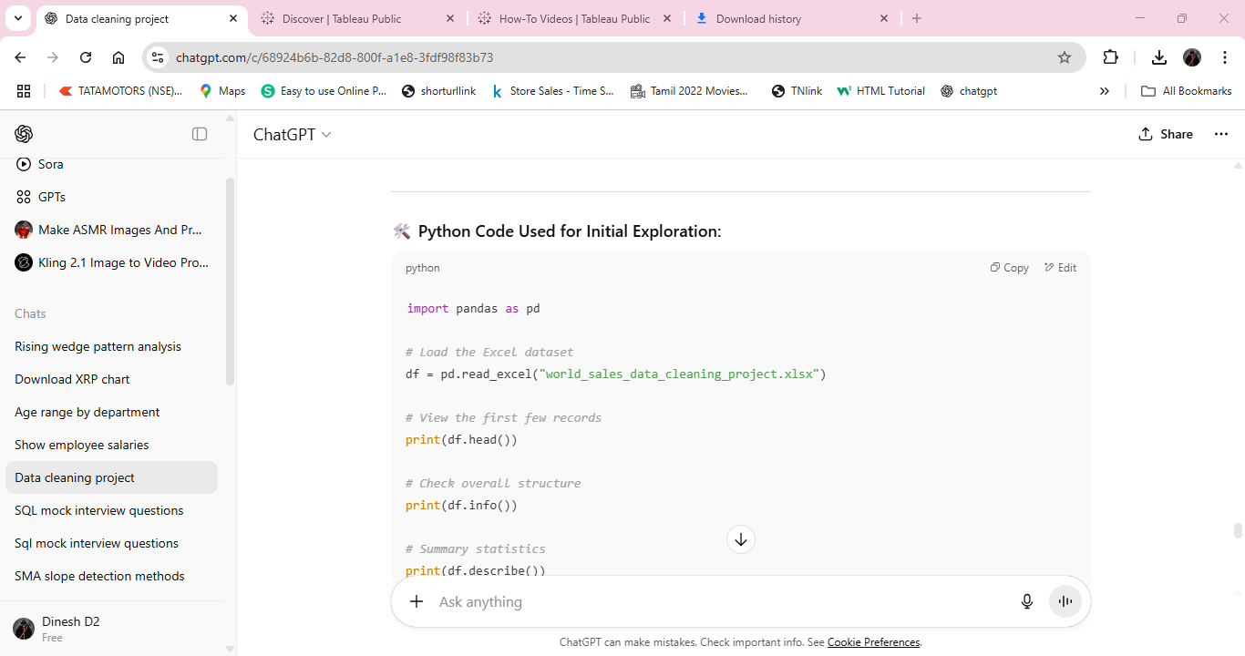
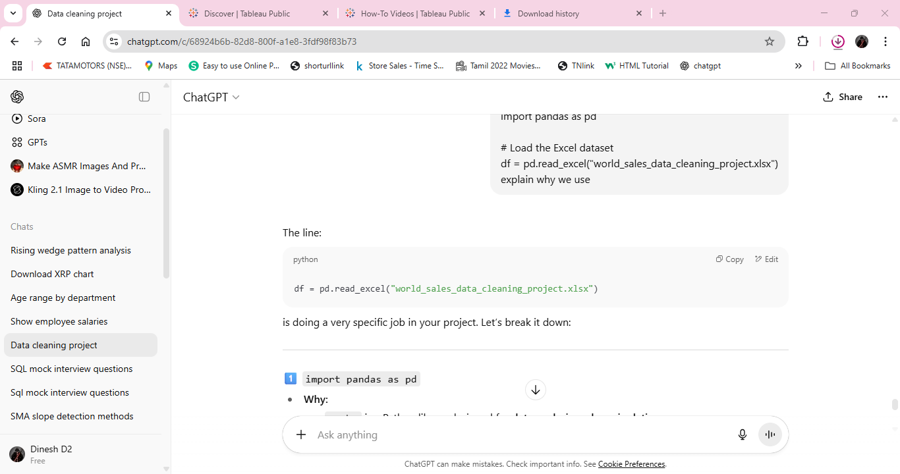
Why:
> pandas is a Python library designed for data analysis and manipulation.
>The pd is just a short alias so you don’t have to type pandas every time.
Why:
>This function reads an Excel file (.xlsx or .xls) and loads it into a DataFrame.
>A DataFrame is like a spreadsheet in memory — with rows and columns — that you can easily clean, filter, and analyze.

Slide 5
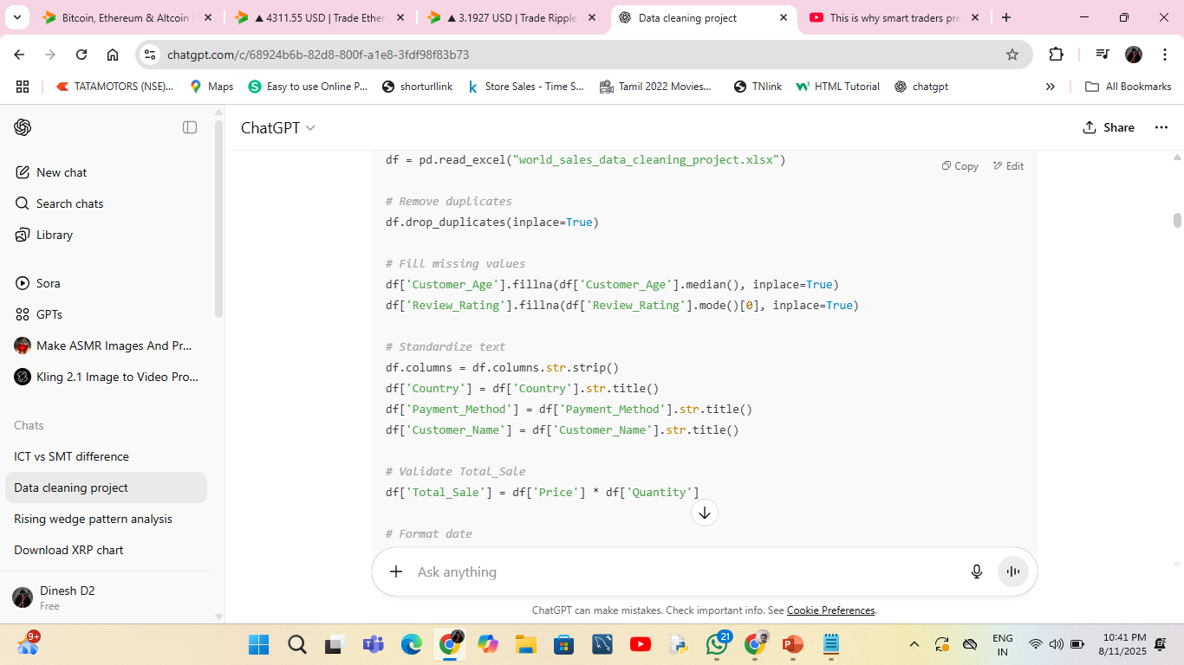
Why Remove Duplicates?
>Avoid double counting – If the same sale or record appears
twice, your totals (like revenue or quantity) will be overstated.
>Data accuracy – Duplicates can distort averages, counts, and statistics.
>Better model training – For ML, duplicate data can cause the model to bias towards repeated values.
>Storage & performance – Unnecessary rows take extra memory and slow down processing.
>df.drop_duplicates() → Finds rows that have exactly the same values in all columns.
>inplace=True → Modifies the DataFrame directly.

Slide 6
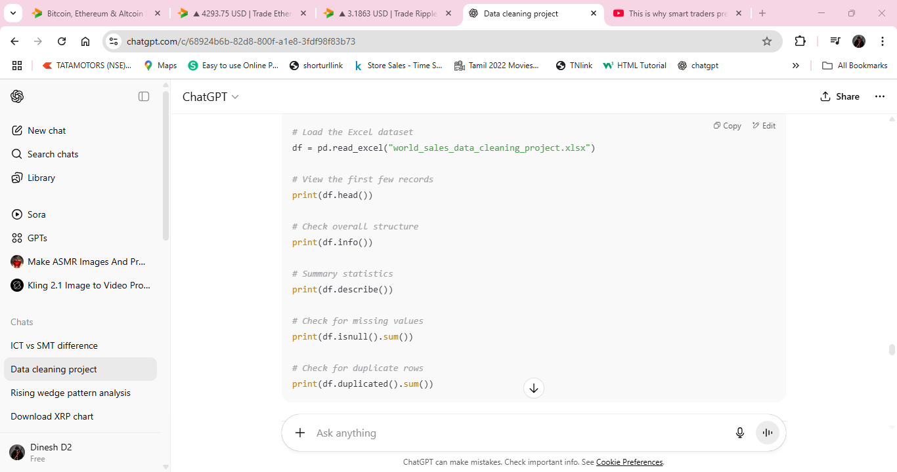
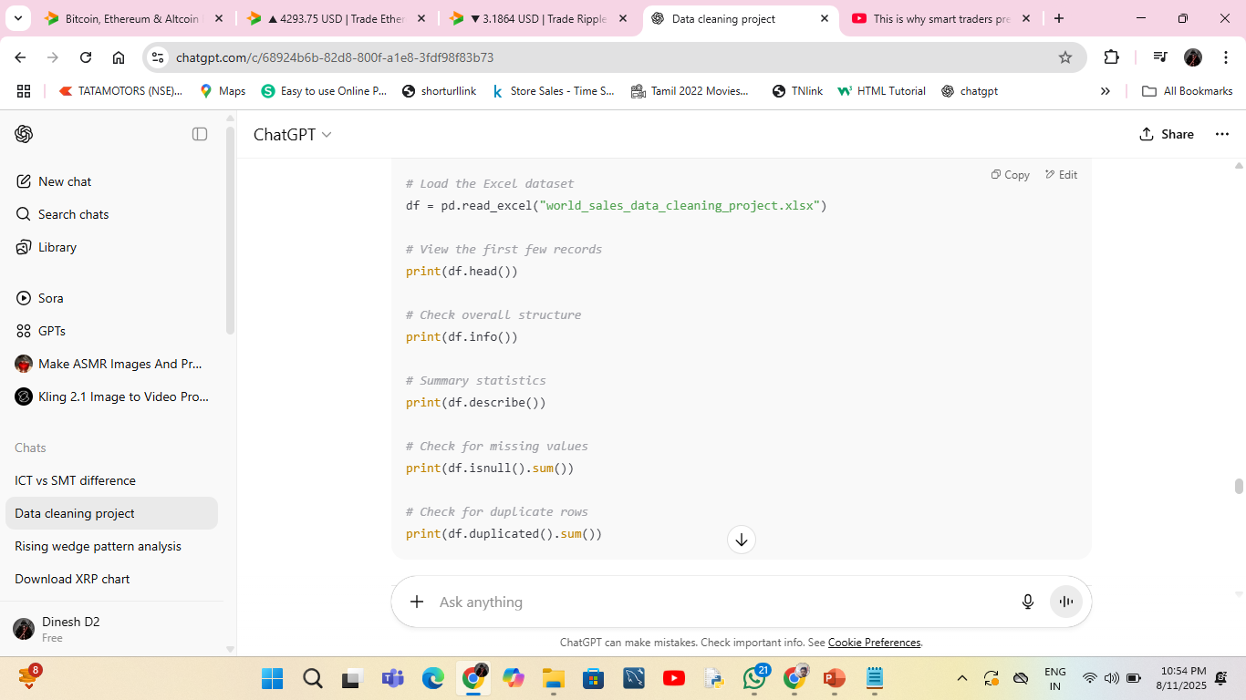
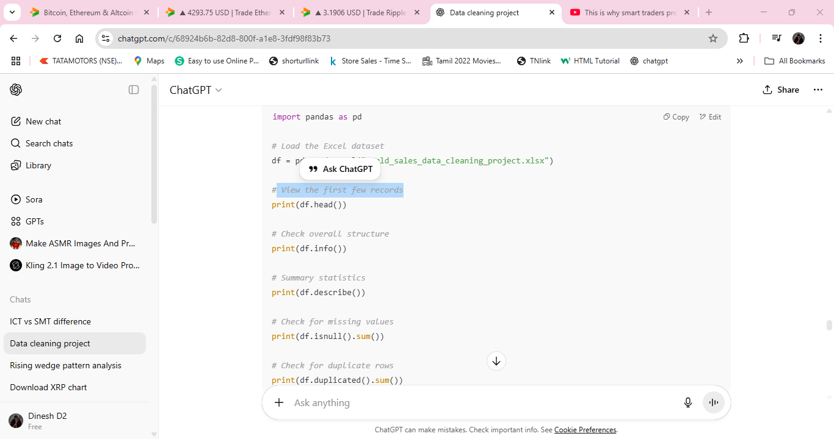
Shows column names, data types, and non-null counts for a quick dataset overview.
Provides summary statistics (mean, min, max, etc.) for numeric columns.
Counts missing (NaN) values in each column.
View the first few records

Slide 7
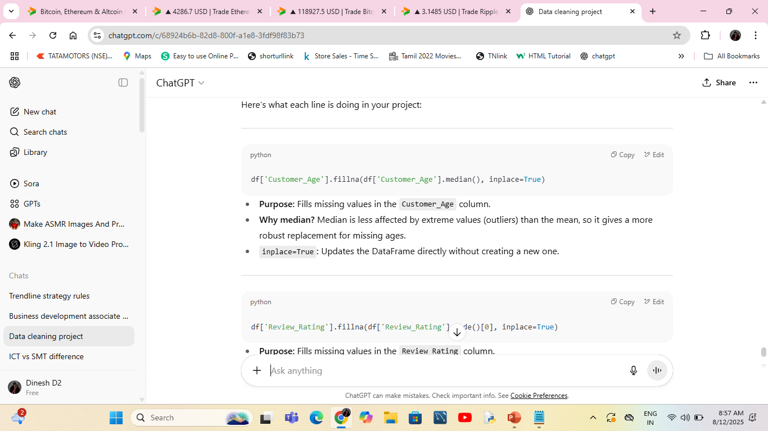
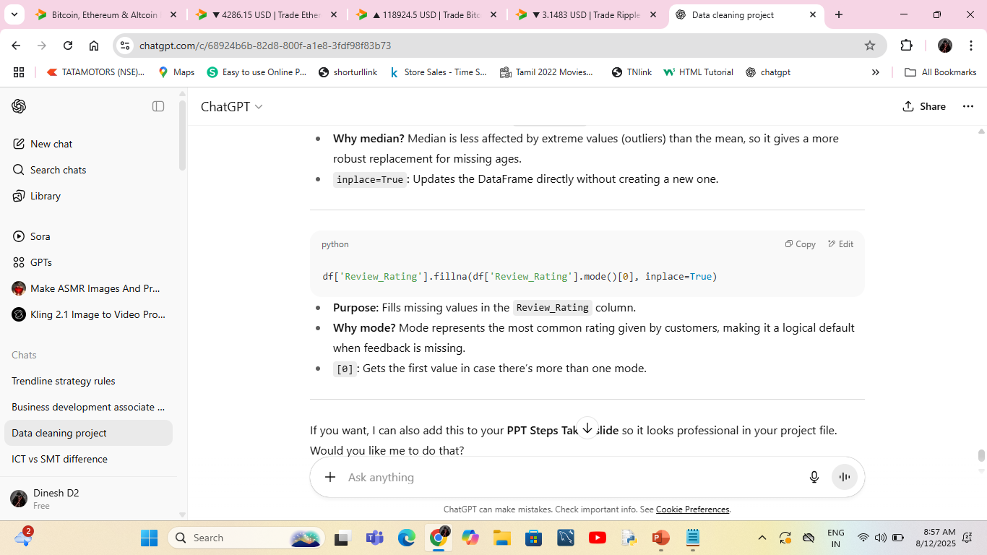

Slide 8
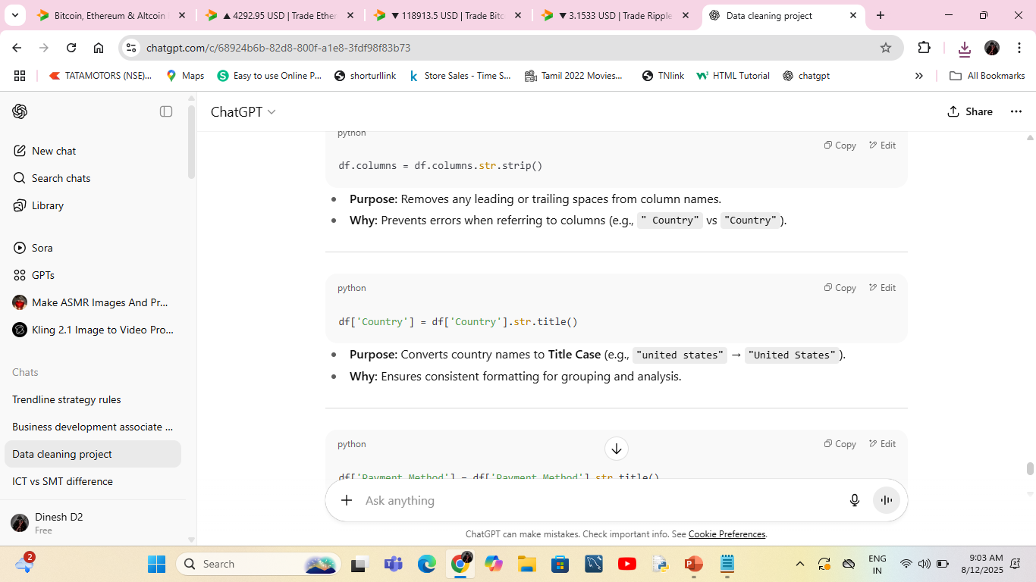
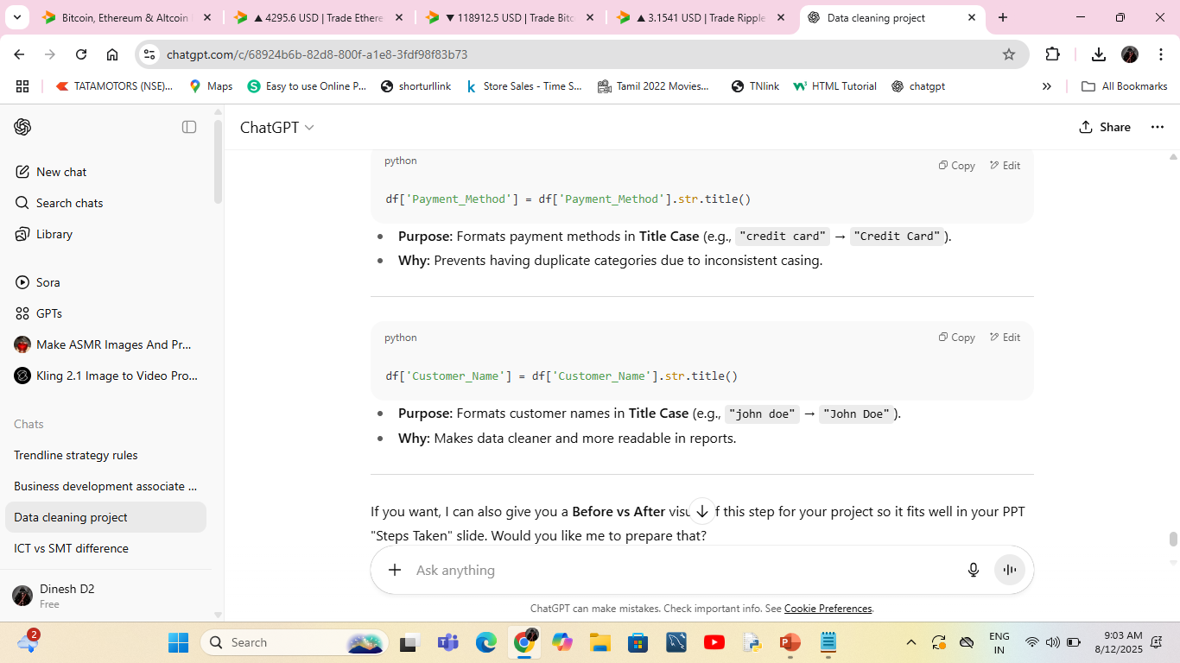

Slide 9
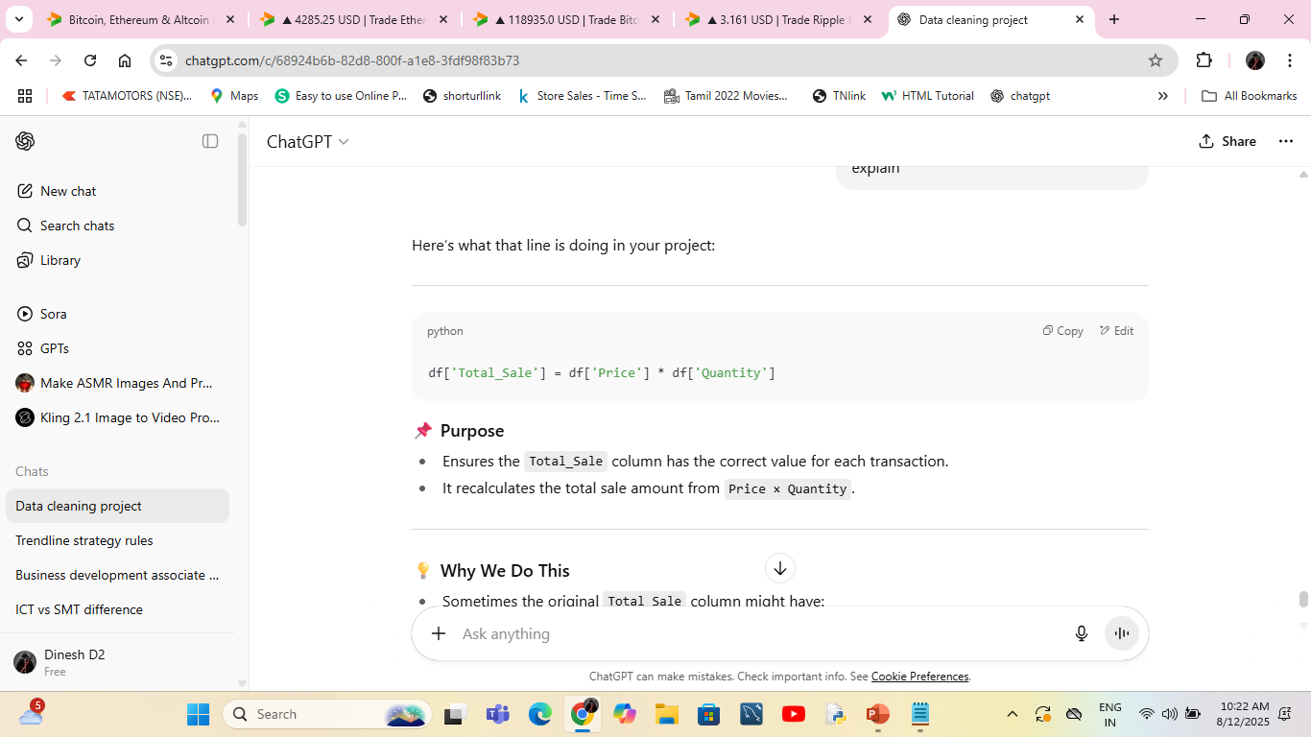
Purpose
Ensures the Total_Sale column has the correct value for each transaction.It recalculates the total sale amount from Price × Quantity.
Why We Do THIS
Sometimes the original Total_Sale column might have:Incorrect calculations (data entry errors)Outdated values after updates to price or quantityMissing values for some rowsBy recalculating it, we guarantee accuracy and consistency.

Slide 10
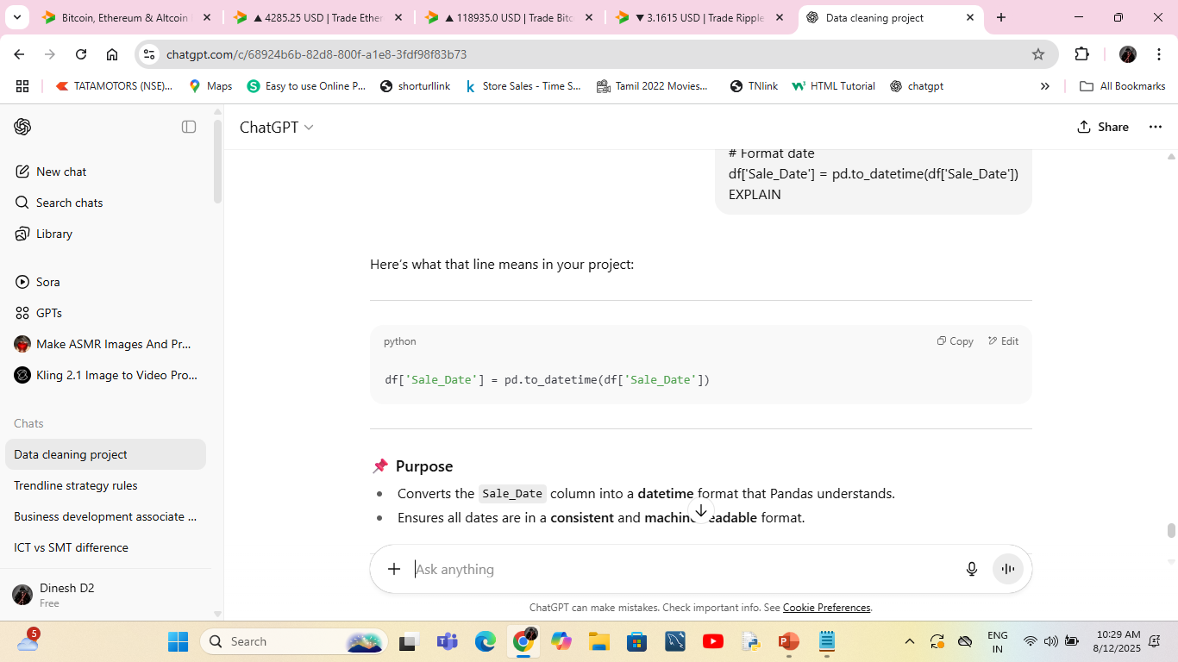
Purpose
Converts the Sale_Date column into a datetime format that Pandas understands.Ensures all dates are in a consistent and machine-readable format.
Why We Do This
Your Excel or CSV might store dates as:
Text strings ("2024-05-09")
Mixed formats ("05/09/2024" and "2024-05-09")
Even numbers (Excel serial dates)
Inconsistent date formats can cause sorting, filtering, and analysis errors.
Datetime format is required for:
Filtering by year/month/day
Calculating durations (e.g., days between sales)
Grouping sales by month or quarter

Slide 11

Pandas
A powerful Python library for data manipulation and analysis.
Allows working with data in DataFrames (like Excel tables but faster and more flexible).
Functions used in this project:
read_excel() → Load Excel file into Python
drop_duplicates() → Remove duplicate rows
fillna() → Handle missing values
str.strip() & str.title() → Clean and standardiz text
to_datetime() → Format date columns

Slide 12
Conclusion
Cleaned Data = Reliable Analysis
Data quality directly impacts the accuracy of results. A well-cleaned dataset ensures trustworthy outcomes.
Structured Data Supports:
📊 Dashboards & Visualizations → Better business reporting
📈 Insights & Decision-Making → Accurate trend analysis
🤖 Machine Learning Models → Improved training accuracy
Project Outcome:
The dataset is now free from duplicates, missing values handled, formats standardized, and totals validated — ready for business intelligence and predictive analytics.

